Slide 1
2019
c
New life
In New York
c
This year, a dream and new challenge just begin…

Slide 2
ontents
What do you need
How to prepare
Life start
A choice for you

Slide 3
1
What do you need

Slide 4
What do you need?
Toefl / GER(I think it will be waived in the future)
I recommend you to start as early as you can. It’s a hard road to go through…
Degree map
We have some limited in this program, so you should decide your two year degrees at the beginning.
Adequate determination
You should totally be sure about it is the road what you wanted.
Documents
I-20, I-94, vaccine, tuberculosis, bank transmission,… lots of things to do after you get the I-20

Slide 5
2
How to prepare

Slide 6
How to prepare?
Take the toefl test
  you might have to take it more than one time
Find out what courses are you interested in
  You can find them online
Be Positive and Patient
  Keep tracking the progress
Scholarship
  學海飛颺(國研處)

Slide 7
3
Life Start

Slide 8
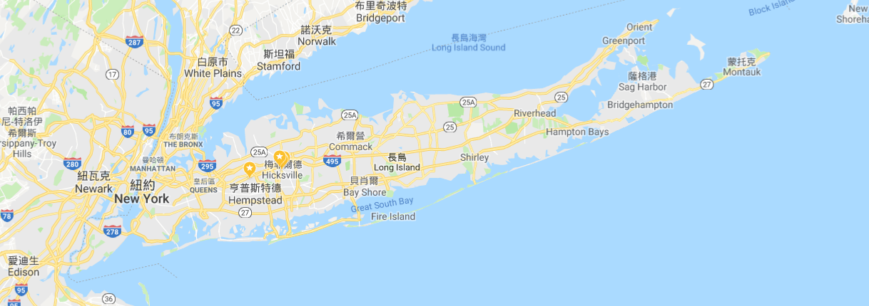
Long Island

Slide 9

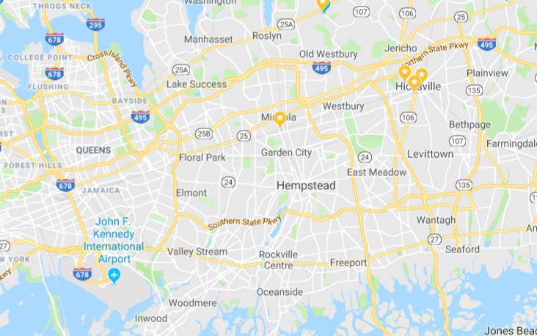


Long Island

Slide 10
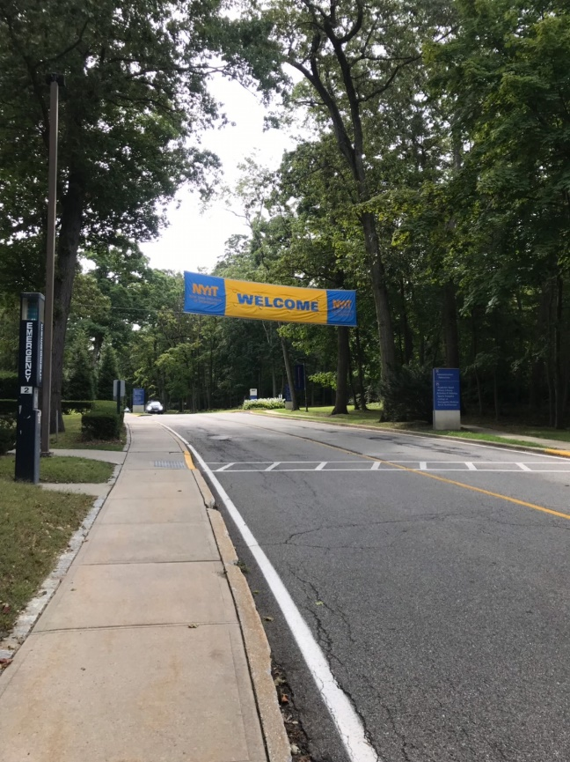



NYIT campus
Shuttle bus

Slide 11




NYC

Slide 12

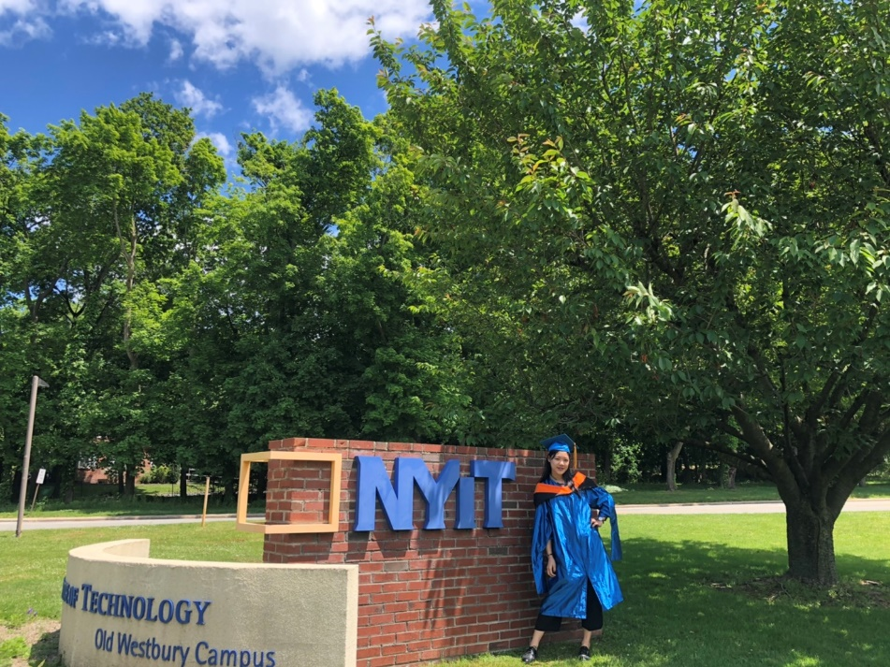

Graduate from NYIT

Slide 13
4
A choice for you

Slide 14
A choice for you
Optional Practical Training (OPT)
STEM OPT Extension-science, technology, engineering and math (STEM) fields :
36 months of OPT
3 times to roll for H-1B visa

Slide 15
We believe we can be better.

Slide 16
For any further information
Email : letitia850723@gmail.com
Line : letitiaku
Facebook : 顧晏如
Feel free to let me know if you have any question.
I hope one of you can make a decision to change your life

Slide 17
c
Thanks！
c

